Slide 1

Big Data Class
Prof. Abhishek Dubey
Sayyed Mohsen Vazirizade
NFD Data Set
March/22/2021

Slide 2
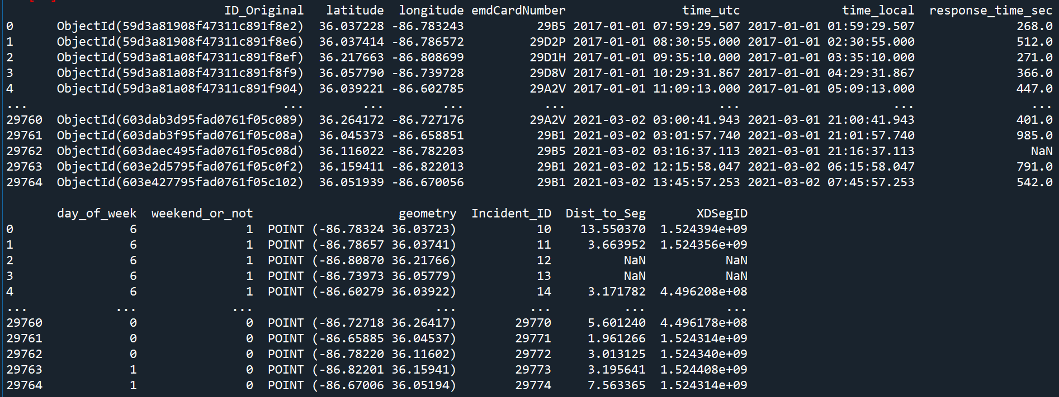
Incident Data Set Summary
ID_Original: A unique ID comes with the data
Latitude, Latitude: Coordinates of the incident
emdCardNumber: defines the type of the mission: https://wiki.radioreference.com/index.php/Priority_Dispatch_Codes
time_utc: the time the incident was reported in UTC time zone
time_local: the time the incident was reported in local time zone
response_time_sec: the time between the report and when the first responded arrived on the scene
day_of_week: day of week the incident happened (0 - Monday, 6 - Sunday)
weekend_or_not: identifies Sunday or Saturday
Geometry: location of the incident
Incident_ID: A unique generated ID
Dist_to_Seg: distance to closest XDSegID, which comes from inrix
XDSegID: the closest XDSegID, which comes from inrix

Slide 3
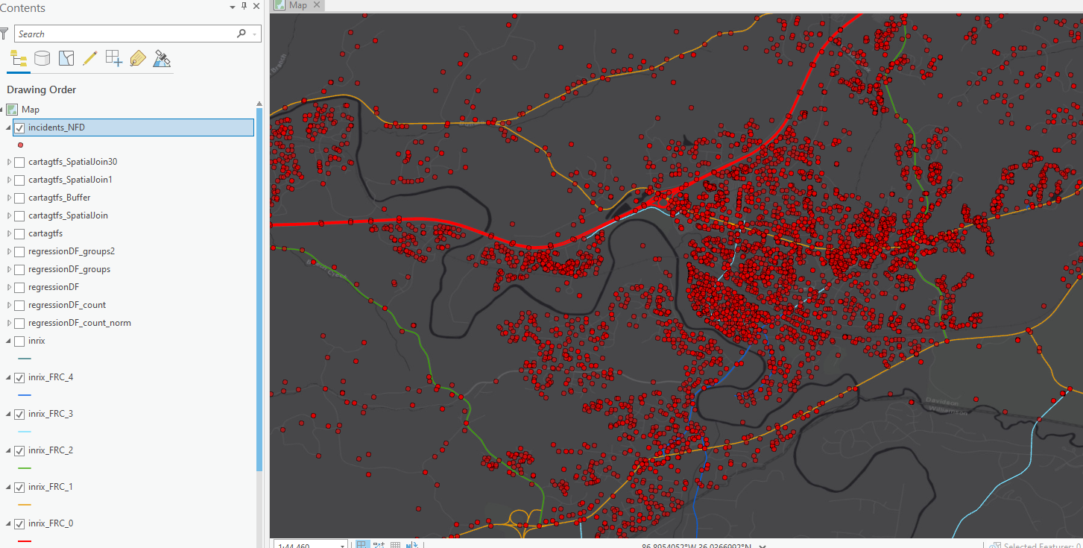
Incident Data Set XDSegID
If there is no roadway segment closer than 25 m to an accident, that accident will not have a closest roadway segment
Inrix

Slide 4
Hint
You may need to create some features. For example, weekend_or_not is already created but you may need to create features such as month.

Slide 5
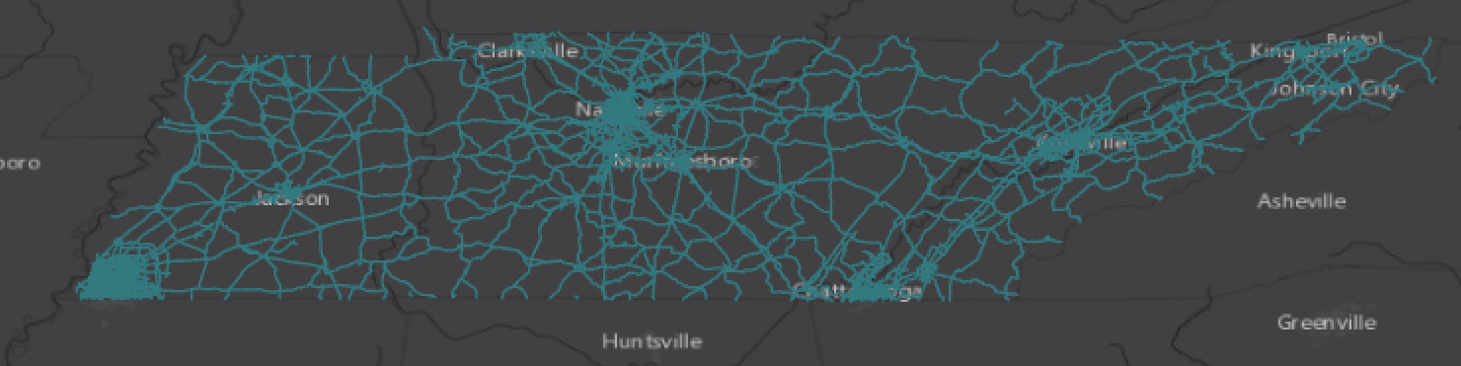
Roadway Data Set Inrix
XDSegID :unique value introducing the id of the segment
geometry:
FRC: Road Type, 0: National highway, 1: State highway, 2: Interconnecting, 3: Major connectors, 4: Minor roads
County_inrix:ame of the country the segment located
Miles: length of the segment
Lanes:number of the lanes

Slide 6
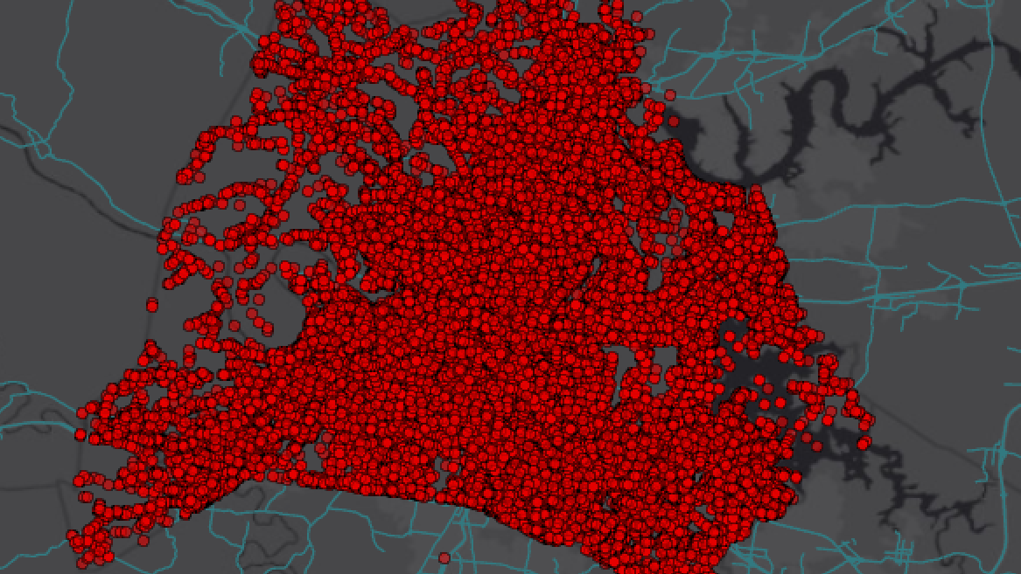
Incident and Roadway

Slide 7
Questions should be answered:
1) spatial analysis of the incidents
2) temporal analysis of the incidents
3) how is the response time distribution
4) effect of time and space on response time
Bonus: A Traffic Data set is available. You should investigate the relationship between response time and incident occurrence.

